Slide 1
APIs

Slide 2

What Are APIs?
“it is a set of clearly defined methods of communication between various software components” Wikipedia
Control and Commands
Data
Signals (Error and Events)

Slide 3




Why are they important
Work with others (Teams)
Deliver SW to third parties
Modularity (concept of black-box)

Slide 4
Examples of APIs

Slide 5
Examples of APIs you have used
C/C++: stdio and stdlib, e.g, (printf(....), rand())
Firebase exercise you have done

Slide 6
Types of APIs
Service based APIs
Google MAP API
YouTube API
Twitter API
Library based APIs
FFMPEG API
OpenCV API
TensorFlow API
HW based APIs
OpenGL

Slide 7
Important Concepts
Synchronous APIs
When you call the API, you will be blocked till the module you called returns
Simpler and could be needed
Example:
Version of the module you are interacting with
Capabilities of the module you are interacting with
Availability
Asynchronous APIs
Your program will not be blocked. It will receive a callback or events from the module
More efficient and provides better experience when dealing with data
Example:
WEB: User interface and data
App can be displayed first
Data can come when available

Slide 8
Industry Service APIs
oAuth
WEBRTC
Service APIs
Amazon
Twitter
Facebook
Google

Slide 9
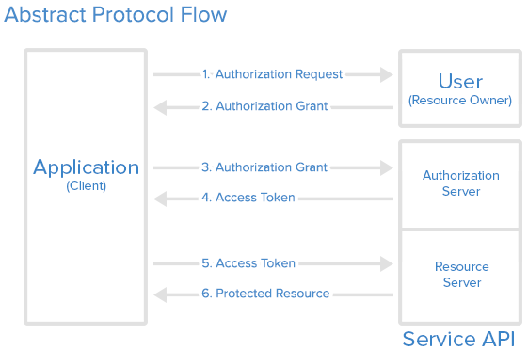
Sequence Diagram
Reference: https://www.digitalocean.com/community/tutorials/an-introduction-to-oauth-2

Slide 10
Let’s look at examples
Let’s go to Google.com
Twitter API example

Slide 11
XML

Slide 12
Exercise for you (30 minutes)
Download the twitter example
Make sure you run: > pip install tweepy
Create a twitter account or use yours
Go to https://apps.twitter.com/ and create an app
Outline the APIs you are using
Go over the call sequence
Execute and explain how it all worked
Add more APIs and use

Slide 13
Thank you

